Slide 1
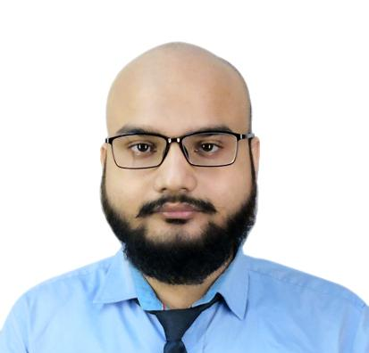



Deeptaragh Roy
Analyst/Software Engineer
Bachelor of Computer Application : 2017 – 2020
Master of Computer Application: 2020- 2022
Mumbai
Skills
DEEPTARAGH.ROY@CAPGEMINI.COM
Java 8 /J2EE | Java Basics, OOPS, Generics, Collections, Arrays, Loops, Lambda Exp, Stream API Junit, Mockito, Servlets
Spring core | IOC & Dependency Injection, Autowire
Spring REST | REST controllers, Implementation of GET, POST, PUT & DELETE, Bean Validation & Exception Handling, Testing Services, Controller & Repository layer
Spring Data JPA | Implement DAO layer using spring Data repositories, Transaction Management
Spring Boot Microservices | Spring Boot Starters, annotations, Swagger API documents
Spring Cloud | Eureka, Netflix Hystrix, Spring Cloud Config Server
React | Components, Hooks, Event handling, Redux, Reducers, Testing using Jest, axios, react bootstrap.
Database | MongoDB Atlas Basics My SQL RDBMS Basics
UI Tech | HTML 5 & CSS 3,JavaScript, ES6
Tools | Git, Postman, Maven, Spring Tools Suite IDE
Add On skills | Communications, and Peer learning
+91 9051737601
A4
Full Stack Developer
Hands on experience in creating microservices with Springboot, Spring Security, Spring Cloud API Gateway, Eureka server, load balancing, Swagger, RabbitMQ.
Proficient in creating Single page Web Application in React with Authentication with routes, react bootstrap, redux, axios, tooltips.
Hands on experience in implementing polyglot architecture with spring boot.
Hands on experience in implementing MongoDB Atlas & PostgreSQL
Experience in creating documentation with Java docs and swagger and in unit testing using Junit, Mockito.
E-Shopping Cart Application
Completed end to end case study of Shopping Cart Application along with JWT authentication, Swagger and payment using PayPal, responsive UI with react bootstrap and React used for user interface.
Bus Booking Application
Created Bus Booking Application and got certified in Capgemini Accelerated Mentorship Programme on Java Full Stack with React.
Check out my work on GitHub & Video Profile

